Slide 1
Home Use Fingerstick Technique Training
Notes:
When testing yourself with the CardioChek®, A1CNow® Self Check system or using the PTS Pod™ collection system at home, it is important to have a good fingerstick technique. Let’s walk through the steps to make sure we get enough blood for the test.

Slide 2
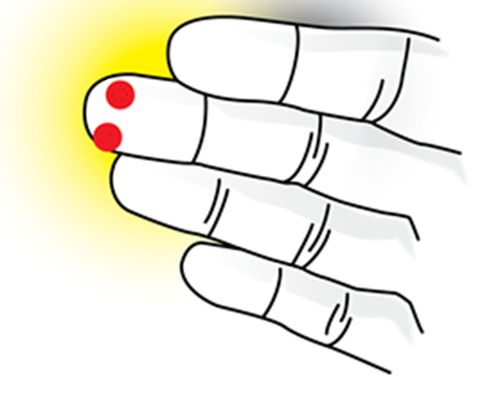
Home Use Fingerstick Technique Training Finding the Site
Top
Bottom
The middle or ring finger of the non-dominant hand for fingersticking is a good site
Select the site to allow for convenient collection
Notes:
First, warm your hands to increase blood flow. This can be done by washing your hands in warm water or rubbing your hands together vigorously. This increases the blood flow to your fingers for an easier and a more comfortable fingerstick.
Next, select the best site for the fingerstick. A good site is at the side of the end of your middle or ring finger of your non-dominant hand. Don’t use the center or pad or the very tip of the finger because there may not be enough blood, and it might be painful. If using the PTS Pod™ collection system, it will be best to stick the bottom side of the finger. If using the A1CNow® Self Check or CardioChek® systems, either the top or bottom of the finger may be most convenient.
Some additional tips for good technique are:
- Wiggle or exercise your fingers;
- Hold the fingers downward and below your heart;
- And shake or wave your hands while keeping your fingers pointed downward to ensure good blood flow before the fingerstick.

Slide 3
Home Use Fingerstick Technique Training Prepping and Sticking
With your hand and arm horizontal, clean the fingerstick site with an alcohol wipe
Place the end of the lancet against the fingerstick site and push firmly to stick finger
Notes:
Hold your finger while keeping the hand and arm horizontal and / or somewhat lowered, then clean the site with an alcohol wipe. Make sure to dry the site with a gauze pad or a cotton ball.
Apply pressure to your lower knuckle on the selected finger, and hold the pressure until your fingertip turns red. If you do not see the fingertip turn red, try to wiggle or exercise your fingers, holding the fingers downward and below your heart. Shake or wave your hands while keeping your fingers pointed downward to regain good blood flow.
Prepare the disposable lancet by following the lancet manufacturer’s recommended instructions. For some people, it is more comfortable to place the finger on a hard surface on its side for support and stability while self-sticking. Remember, this may mean turning your hand over to reach the best side for collecting your sample. Be sure the desired spot for the fingerstick is facing straight up.
Stick the finger with the lancet by following the lancet manufacturer’s recommended instructions. Placing the lancet very firmly against the skin while the finger is on the table is likely to produce the best and most comfortable stick, as it helps to ensure the lancet will not wiggle.
Dispose of the lancet in the appropriate container.

Slide 4
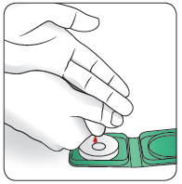
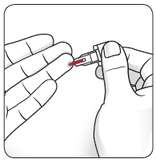
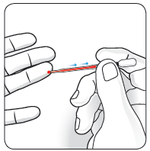
Home Use Fingerstick Technique Training Collecting Blood
Gently apply pressure on your finger to collect the necessary volume of blood using the provided collection system
Notes:
Holding pressure on the knuckle until the fingertip turns red and then releasing the pressure will help to form a large drop of blood. It may be necessary to wipe away the first drop of blood prior to collecting for your test, for example, when using the CardioChek® analyzer with the PTS Panels® test strips. Wiping away the first drop is not required for all tests, such as when using the PTS Pod™ system or A1CNow® Self Check system. Be sure to refer to the package insert for your test for more details.
If blood appears to have stopped flowing, apply pressure to the knuckle again, and then release. This can be repeated until the full sample has been collected. You can also massage the finger from the hand to the tip to help blood continue to flow. You may try adding increased pressure at different sites throughout the finger to help stimulate increased blood flow.
The blood can be collected using the PTS Pod system, the blood collector provided with the A1CNow Self Check system, or the PTS Diagnostics™ capillary tubes provided with the CardioChek analyzer. After the required amount of blood has been collected, apply a bandage to your finger and complete the test according to the package insert.

Slide 5
Customer Service Thank you!
PTS Diagnostics Customer Service
U.S. Toll-Free: 1 (877) 870-5610
International: +1 (317) 870-5610
Hours of Operation: 6:00am-9:00pm EST, Monday through Friday
PTS Pod, A1CNow, CardioChek, PTS Panels and PTS Diagnostics are trademarks of Polymer Technology Systems, Inc. © 2016 Polymer Technology System, Inc. LIT001777 r0 03/16
Notes:
This successfully completes training on Home Use Fingerstick Technique!
If you have any questions in the future, please contact our Customer Service team at the number listed on the screen.
Thank you again for your time and attention during this training!

